Slide 1
UNIT 1: INTERPRETATION
1: The Value of Data + Data Narratives
2: Excel Fundamentals
3: Data Referencing
4: Data Aggregation
5: Data Visualization
6: Statistics in Excel*
James Larkin – Data Analytics Instructor
Notes:
* Indicates a FLEX lesson

Slide 2
FUNDAMENTALS OF DATA IN EXCEL

Slide 3
FUNDAMENTALS OF DATA IN EXCEL
OPENING

Slide 4
LEARNING OBJECTIVES
FUNDAMENTALS OF DATA IN EXCEL
In today’s lesson, we will:
Discuss data cleaning best practices.
Review strategies to prepare and clean a data set.
Practice asking the “right” questions of our data.

Slide 5
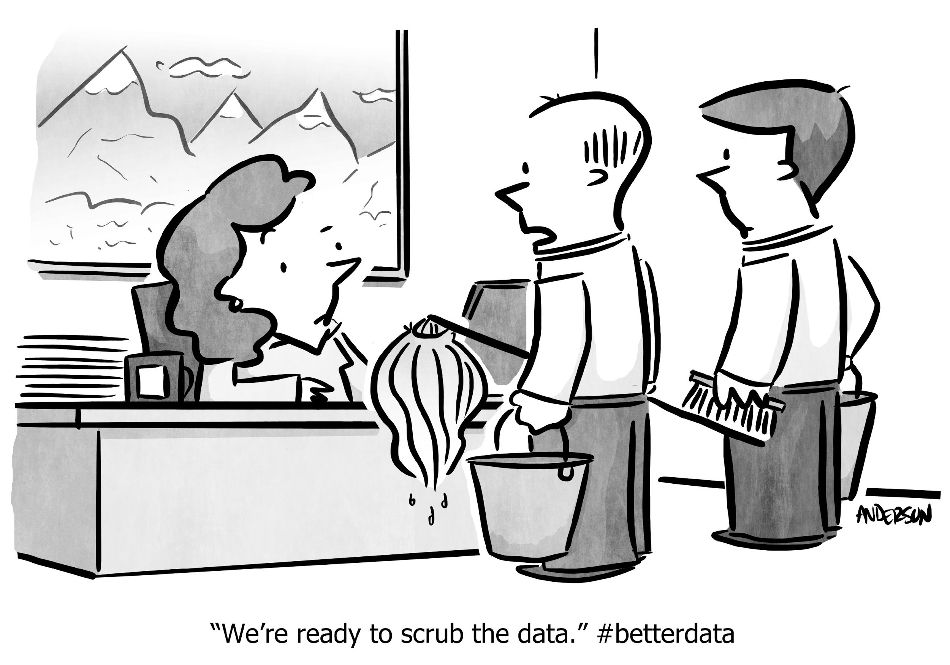
FUNDAMENTALS OF DATA IN EXCEL
DATA CLEANING

Slide 6

FUNDAMENTALS OF DATA IN EXCEL
KEEP A COPY OF ALL UNTOUCHED, RAW DATA.
Document ALL of the steps you take in your analysis.
Always create a working summary sheet for yourself, that includes the following:
A directory of other sheets.
An explanation of analysis.
A short summary of your results.
BEST
PRACTICES

Slide 7
FUNCTIONS + METHODS
HOW TO CLEAN DATA IN EXCEL
Duplicates
Auto filter
Concatenate()
Trim blanks/spaces
Boolean operators
Strategy for nulls.
Cleaning non-printing characters
Uniform appearance (upper, lower, proper)
Date field selections
Numeric column settings
Text to columns
Aggregation (%, avg, sum)
Substitute data if needed

Slide 8
DATA REFERENCING IN EXCEL: NULLS
A NULL is any missing value in your data. There are four primary strategies for handling NULL values:
Delete them (only with caution).
Ignore them (some may have meaning).
Impute values (e.g. median or zeros).
Find missing values (using reference resources).
Guideline: If over 15% of a dataset is filled with NULL values, find new data!
Notes:
Instructor Prompt: Ask the class and see if any of them are familiar with their company or organization’s policies for handling NULL data. If not, ask them to look this up as homework for next session. Most companies with established data teams have a clear policy here.

Slide 9
FUNDAMENTALS OF DATA IN EXCEL
BUSINESS SCENARIO

Slide 10
BUSINESS SCENARIO - WASHINGTON CENSUS (ACS)
In this scenario, we’ll be working for the Washington State Governor’s Office as a policy analyst.
Policy analysts often use many different data sources to evaluate policy decisions and make recommendations for how to allocate resources, hold entities accountable, and more.
We’ll be using data from the American Community Survey (ACS), which is a random survey given to U.S. residents each year.

Slide 11
BUSINESS SCENARIO
The ACS survey is a bit different from the standard US census:
During a census, everyone is asked to respond.
Sampling is used in off years to provide estimated data about the population.
For the ACS, approximately 1/38 households are asked to respond.
Because it’s a sample, each variable is an estimate that has an associated degree of error, based on number of respondents, sampling strategy, and more.

Slide 12
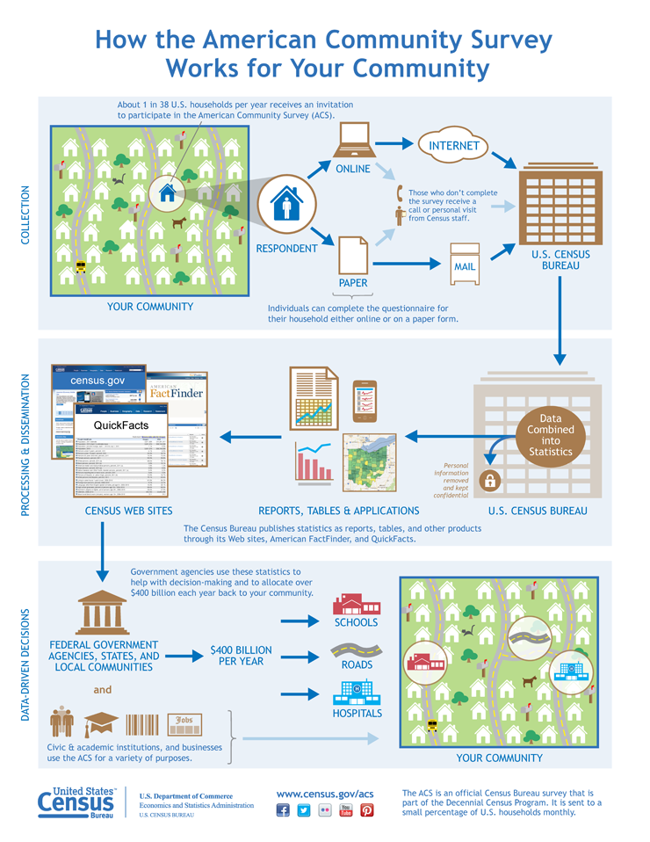
BUSINESS SCENARIO
Here is a diagram from the U.S. Census Bureau depicting how the ACS works:
Source: http://www.census.gov/programs-surveys/acs/about/how-the-acs-works.html
Notes:
Talk about how those who don’t respond receive a visit in-person. This makes sure that the sampling isn’t biased (i.e. folks who tend to respond may have more free time; perhaps they don’t have kids or are unemployed; or are older)

Slide 13
FUNDAMENTALS OF DATA IN EXCEL
INDEPENDENT PRACTICE: CLEANING OUR DATA SET

Slide 14

INDEPENDENT PRACTICE: CLEANING OUR DATA SET
A significant amount of any project involves cleaning data (usually between 50–80%) and performing basic exploratory analysis in order to develop a working knowledge of the dataset.
Only after you understand the nuances of a data set and have normalized its structure (by dealing with any NULLs, for instance) can you advance and begin analyzing it.
Develop hypothesis- driven questions
Select, import, & clean
Structure, visualize, analyze
Create business decisions
Present data-driven findings
*Source: https://goo.gl/UivUn4

Slide 15
INDEPENDENT PRACTICE: CLEANING OUR DATA SET
Here’s important information you need to know about our data set:
Many of the ACS tables have data aggregated by census tracts.
Census tracts are small areas — sometimes as small as a few blocks in a densely populated area — that the ACS uses for tabulation.
Each census tract has an ID, which is the “id” field in our data set.
Because we’re working for the state of Washington, our data set only includes census tracts in Washington.
Notes:
Census tracts are small areas
This is the ID field of our dataset
Area in consideration is Washington

Slide 16
INDEPENDENT PRACTICE: CLEANING OUR DATA SET
Here’s more important information you need to know about our data set:
Sometimes data are reported as a total of those counted.
For example, the data set contains the total female population of a census tract, but it doesn’t have the percentage of people who are female.
Other times, data are reported as percentages.
For example, the unemployment rate is provided in the data set.
In order to be able to perform analysis using the ACS data set, we’ll need to make some changes and do some exploration.

Slide 17
ACTIVITY: CLEANING OUR DATA SET (BREAK OUT GROUPS)
DIRECTIONS
EXERCISE
Open 2014_acs_select_WA.xlsx.
Based on your experience, choose either the BASE or STRETCH tab to complete (45 min).
You may work with a partner, checking in with each other after answering each question.
DELIVERABLE
Complete the BASE or STRETCH tab in 2014_acs_select_WA.xlsx.
Be prepared to share an observation or analysis from question No. 4.
Notes:
Open the data set from the link (note that there are also cleaned/finished worksheets, as well as solution worksheets in the resources folder of this lesson
The assignment is written on the ‘base’ and ‘stretch’ sheets of the workbook, stretch is everything in base, only without any hints/guidelines

Slide 18
INDEPENDENT PRACTICE: CLEANING OUR DATA SET
Let’s go over each column header and see what the data looks like.
Let’s freeze the top row so we always see the column header: View > Freeze Panes > Freeze Top Row.
Let’s Wrap Text on the first row to let us read all of the column headers: Home > clicking row number to highlight >Wrap Text.

Slide 19
FUNDAMENTALS OF DATA IN EXCEL
GUIDED PRACTICE: REVIEWING OUR SOLUTIONS

Slide 20
GUIDED PRACTICE: REVIEW SOLUTIONS
Goals:
Combine values to create meaningful relationships.
Create percentage columns for each column that’s not already a percent or rate.
Create a ratio for total population (E) and population of males (M).
Create a new column with the header “% Male of Population.”
Enter the formula “=F2/E2” in the first cell under the header (row 2).
Double-click the square (bottom-right corner of the cell) to copy down all rows.

Slide 21
GUIDED PRACTICE: REVIEW SOLUTIONS
Goal: Convert all percentage columns to values between 0–1 (inclusive) with a format of “00.00%.”
Two methods we can use:
Create a new column equal to the old column but divided by 100.
Use Paste Special’s “Divide” feature.

Slide 22
GUIDED PRACTICE: REVIEW SOLUTIONS
Goal: Remove all rows with no data.
What do you do with rows that are completely empty?
Always document what you delete and make a note of the reason.
Notes:
Instructor Notes: For rows that are empty, note that this may typically be decided on a case-by-case basis, depending on the data policy involved. Sometimes empty data is sometimes very useful.
But for our purposes, since we’re making policy recommendations about people who live in these census tracts, we can delete these rows.

Slide 23
GUIDED PRACTICE: REVIEW SOLUTIONS
Goal: Create a common code for cells with no data.
It’s important to have empty or null values coded in a consistent way.
This dataset has them represented with both blank and “-” cells.
If there are textual data amid numeric data, Excel will be unable to plot that data correctly.
It’s best practice is to recode all empty cells as blank.

Slide 24
GUIDED PRACTICE: REVIEW SOLUTIONS
Are there any data that could be erroneous? If so, what are our options?
Click through each column’s filter dropdown and take a look at the values. Do you see anything out of order?
For now, there’s not much we can do except document our findings. Make a note about the age field and others that might be questionable.
To help us determine if the median age is unreasonable, you may need to look up information about the questionable tract using external reference data to confirm.

Slide 25
GUIDED PRACTICE: SOLUTIONS & FINDINGS TO SHARE
What were some interesting findings?
Exploratory data analysis is always helpful for finding potentially erroneous data, as well as understanding what data you have in your data set.
Scatterplots are great tools for looking at relationships between two variables.

Slide 26
FUNDAMENTALS OF DATA IN EXCEL
CONCLUSION

Slide 27
CONCLUSION
We now have a clean data set that will be used for the remainder of Unit 1.
In the next lesson, we’ll learn about how to use and apply some advanced Excel features, including LOOKUP functions, INDEX, and MATCH.

Slide 28
CONCLUSION
To recap, in this lesson we:
Discussed data cleaning best practices.
Reviewed strategies to prepare and clean a data set.
Practiced asking the “right” questions of our data.

Slide 29
FUNDAMENTALS OF DATA IN EXCEL
Q&A

Slide 30
UNIT RECAP
UNIT 1: REVIEW

Slide 31
WHAT HAVE WE LEARNED SO FAR?
In Unit 1 so far, we have learned how to:
Define methods for thinking about how to solve problems with data, including GA’s data workflow and the five V’s of data.
Explain common strategies for communicating data narratives, including how to:
Prepare your presentation using narrative strategies.
Make the problem and the data the focus of your story.
Identify and answer the key concerns of your stakeholders.
Select your visualizations and colors with clear purpose.
Prepare data effectively for analysis

Slide 32
UNIT REVIEW
Pair up and take 10 minutes to discuss:
What are some key takeaways from Unit 1 so far?
What you can do to make these takeaways actionable or valuable in your team, organization, or workplace?
Be prepared to share your answers with the class.
Notes:
OPTIONAL: RECAP EXERCISE.

Slide 33
FUNDAMENTALS OF DATA IN EXCEL
RESOURCES

Slide 34
RESOURCES
FUNDAMENTALS OF DATA IN EXCEL
For additional resources, check out the student resource direcory.
A thorough guide to the steps of data cleaning: https://www.siop.org/tip/backissues/Jan05/PDF/423_089to096.pdf.
To find these census tracts on a map, you can use this website: https://www.huduser.gov/qct/qctmap.html. To search, enter the portion of the ID after “US.”

Slide 35
CITATIONS
FUNDAMENTALS OF DATA IN EXCEL
The data sets used were compiled from the American Community Survey (ACS): https://www.census.gov/programs-surveys/acs/.
The data sets were downloaded directly from the American FactFinder site: http://factfinder.census.gov/faces/nav/jsf/pages/index.xhtml.
All data sets are from the 2014 5-Year Estimate ACS.
Summary of the ACS Data Collection: http://www.census.gov/programs-surveys/acs/about/how-the-acs-works.html.

